Slide 1
LIBS 7001: Week 7
© BCIT
Adapted from original slides by G.Homel and C.Liotta

Slide 2
LIBS 7001 Week 7:
Comparison and Contrast
identify, discuss, use and evaluate concepts and techniques of comparison and contrast, including
  logical & rhetorical comparison
  analogy and parable
identify and evaluate elements of comparison in sample essays / visual texts
“Organizing a Comparison Essay” slides adapted from: K. Stewart, C. Bullock & M. Allen, Essay Writing for Canadian Students, ch. 9.

Slide 3
What is Comparison?
Comparison shows similarities between people, things, ideas.
Contrast shows the differences.
Comparison includes both kinds of analysis.
Methods or patterns of comparison:
  block: presents one subject fully, then the other
  alternating (point by point): different aspects compared

Slide 4
Why Use Comparison?
SSW, Ch. 9
helps us choose between alternatives
acquaints us with unfamiliar things
examples: comparing
  several phone systems
  candidates for a job
  patient’s condition before and after treatment
  one essay to another
  one potential vehicle to be purchased to another

Slide 5
Purposes of Comparison
to help you and your reader better understand
  the things you’re comparing
  the more general concept that’s the basis for the comparison
basis of comparison: the common element in terms of which you will compare something
  forces you to consider your own ideas and assumptions

Slide 6
Selecting Items for and
Developing a Comparison
Items compared must share some common ground
  many possible points of comparison: nursing & police work; innocence and experience
  no basis for comparison: chicken and charcoal
  (you decide): golfer and a car
Any valid comparison presents many possibilities.
Successful comparisons use ample, well-chosen details to show how items compared are alike / different.

Slide 7
Organizing a Comparison
Block Pattern
say everything you have to say about one subject before discussing the other
useful when you are developing only a few main points (short texts), without extensive quotes or evidence
Alternating Pattern
compare things one aspect at a time
better for essays over 500 words and for detailed comparisons

Slide 8
Organizing a Comparison Essay
1. Clarify Comparison Topics
2. Gather and Categorize Information
3. Formulate a Comparison Thesis
4. Draft the Essay
5. Revise the Thesis and Essay Structure
6. Revise Individual Paragraphs

Slide 9
1. Clarify Comparison Topics
Check for a basis of comparison (assignments) :
  given: compare Blake’s “Infant Sorrow” and “Infant Joy” in terms of language used…
  not given: compare Blake’s “Infant Sorrow” and “Infant Joy” - you could choose: visual imagery; use of dialogue/monologue; colours; theme; use of language; relationship to nature / culture
Look for similarities and differences:
  remember that “compare” always means “compare and contrast” (see “Forensic Nursing….”)

Slide 10
2. Gather and Categorize Information
Decide on a basis of comparison
  provides a focus for your essay
  indicates what material is relevant and what’s not
  helps decide which categories will be most useful in gathering info.
Gather equivalent material in matching categories
  categories should match
  categories should contain roughly equivalent amounts of material (or you must address the imbalance)

Slide 11
3. Formulate a Thesis
Form an opinion about each set of material.
  what point does the material in each category make about the basis of comparison?
Form an opinion about overall similarities / differences
  what generalizations can you make?
Support your opinion about similarities and differences.
  give evidence from the texts, based on your categories

Slide 12
4. Draft the Essay
Select material carefully.
  limit the number of categories you use
  have roughly equivalent amounts of material for each thing you’re comparing
Organize material: use either
  block method
  point-by-point method

Slide 13
5. Revise Thesis and Essay Structure
Make sure your thesis
  makes a point about the basis of comparison -- just stating the point is not enough!
  gives reasons to support your point - clear, specific evidence.
Revise your essay structure.
  choice of block or point-by-point - ok , or needs changing?
  sequence of paragraphs: do they support your thesis logically
  matching points?

Slide 14
6. Revise Individual Paragraphs
Revise middle paragraphs.
  clear topic sentences?
  adequate balance of information about each thing compared?
Revise Introduction.
  establish context in the Introduction; keep balanced!
  give titles / authors / other “basic” info.
  state your thesis
  preview (give “roadmap”) of topics you’ll discuss
Revise Conclusion.
  clarify comparison thesis and its wider implications
  don’t simply re-state as a summary

Slide 15
“Crouching Tiger, Hidden Dragon”: how does comparison help create meaning?

Slide 16
Analyzing a Comparison: Sample Texts
  1. What is being compared? Contrasted?
  2. What is the purpose of the article? Where is the thesis presented?
  3. Does the author’s use of comparison achieve the purpose?
  4. Is the comparison / contrast balanced, fair, and clear?

Slide 17
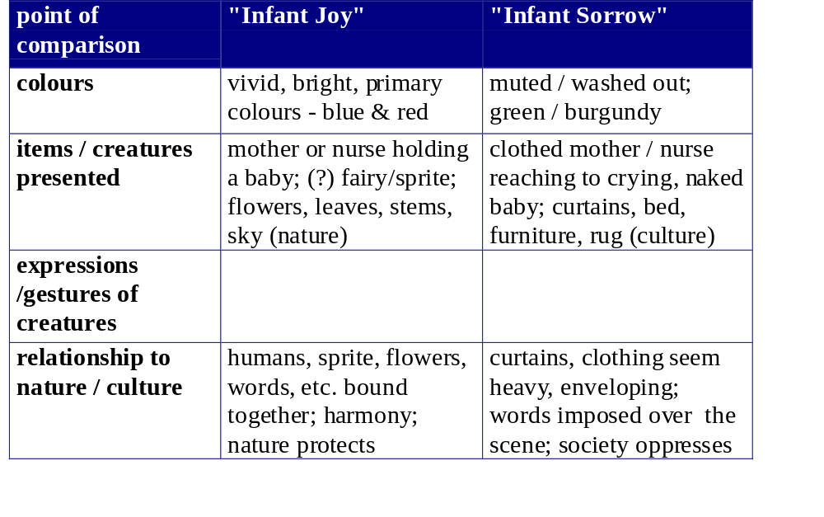
Constructing a Comparison Essay:
Compare “Infant Joy” and “Infant Sorrow” in terms of visual representation

Slide 18
Comparison: Types / Extended
Consistent with the bi-polar approach of western culture, rhetoricians sometimes distinguish between two types of comparison:
  logical / objective / denotative: often used for explaining: The Internet is an information highway….
  rhetorical / subjective / connotative: often used for persuading: This candidate’s like an old horse who’s run too many races….
Other types of extended comparison are analogy and parable.

Slide 19
Analogy
Analogy: (from Gr. analogos, a due ratio) an extended metaphor or simile; a comparison of two quite different things or activities for the purpose of explanation; often used in science writing.
  A child is like a tender plant needing care from a skilled gardener.
  A mind is like a parachute…
Limit your analogies; don’t draw them out to the point of absurdity.

Slide 20
Analogy and Parable
Both are often used to explain a new, complex idea or concept in terms of a situation or idea familiar to the audience.
  Electrical current is like a river…
Parable (from Gr. parabole, a comparing, or throwing alongside): a short, fictitious narrative from which a moral or spiritual truth can be drawn

Slide 21
Parable: Examples
(1) “What shall we say the Kingdom of God is like?” asked Jesus. “What parable shall we use to explain it? It is like this. A man takes a mustard seed, the smallest seed in the world, and plants it in the ground. After a while it grows up and becomes the biggest of all the plants. It puts out such large branches that the birds come and make their nests in its shade.” (NT, Mark, 4, 30-34)

Slide 22
(2) A man traveling across a field encountered a tiger. He fled, the tiger after him. Coming to a precipice, he caught hold of the root of a wild vine and swung himself down over the edge. The tiger sniffed at him from above. Trembling, the man looked down to where, far below, another tiger was waiting to eat him. Only the vine sustained him.
Two mice, one white and one black, little by little started to gnaw away at the vine. The man saw a luscious strawberry near him. Grasping the vine with one hand, he plucked the strawberry with the other. How sweet it tasted! (P. Reps, Zen Flesh, Zen Bones)

Slide 23
Parody
from the Grk., meaning: “a song alongside of”
a writing or “text” in which the style and language of one author is imitated or mimicked, for comic effect or in ridicule (can have a serious, critical purpose)
  e.g., “This Hour Has 22 Minutes” (CBC tv) is set up like a tv news show, but ridicules the pompousness of tv newscasters, the emptiness of some of the stories they present, and also presents insights by this comparison. The comparison between the “real” tv news and “This Hr” creates humour & insight

